Slide 1
Chapter 9: RNNs and LSTMs
Heshaam Faili
hfaili@ut.ac.ir
University of Tehran

Slide 2
Recurrent Networks
Some problems require previous history/context in order to be able to give proper output (speech recognition, stock forecasting, target tracking, etc.
One way to do that is to just provide all the necessary context in one "snap-shot" and use standard learning
How big should the snap-shot be? Varies for different instances of the problem.

Slide 3
Motivation
Not all problems can be converted into one with fixed length inputs and outputs
Problems such as Speech Recognition or Time-series Prediction require a system to store and use context information
Simple case: Output YES if the number of 1s is even, else NO 1000010101 – YES, 100011 – NO, …
Hard/Impossible to choose a fixed context window
There can always be a new sample longer than anything seen

Slide 4
Recurrent Networks
Another option is to use a recurrent neural network which lets the network dynamically learn how much context it needs in order to solve the problem
Speech Example – Vowels vs Consonants, etc.
Acts like a state machine that will give different outputs for the current input depending on the current state
Recurrent nets must learn and use this state/context information in order to get high accuracy on the task
Temporal Deep Network

Slide 5
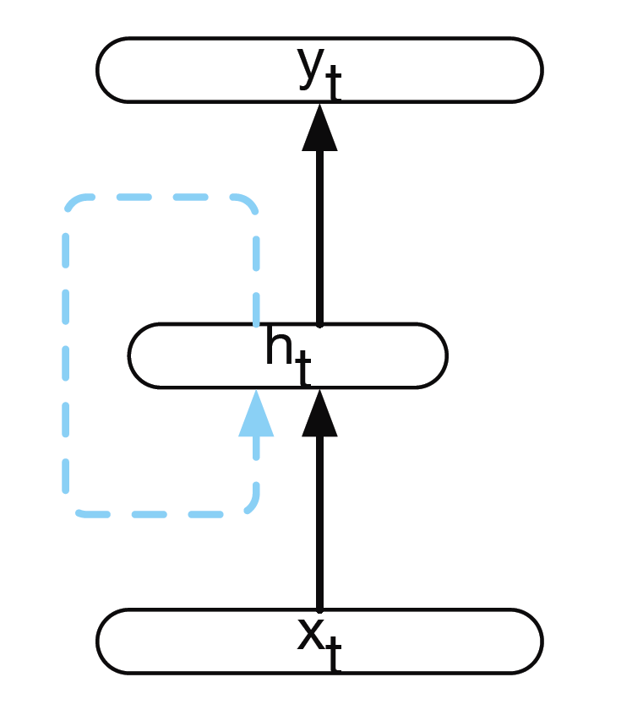
Recurrent Neural Networks (RNNs)
Recurrent Neural Networks take the previous output or hidden states as inputs.! The composite input at time t has some historical information about the happenings at time T < t
RNNs are useful as their intermediate values (state) can store information about past inputs for a time that is not fixed a priori

Slide 6
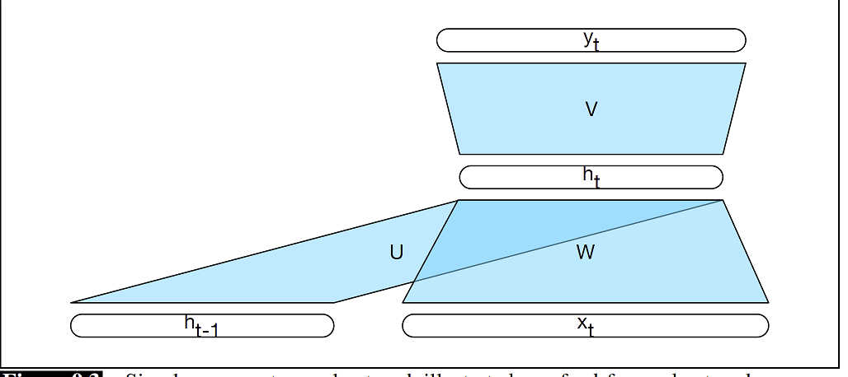
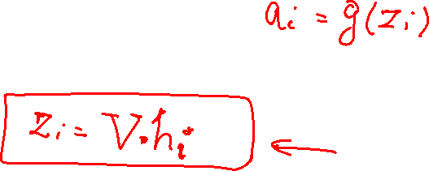
RNN

Slide 7
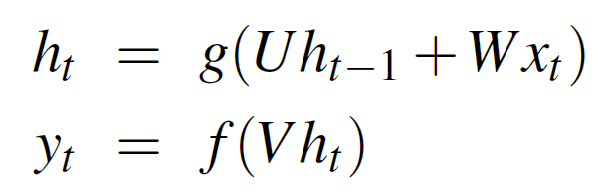
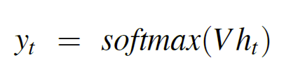
Inference in Simple RNNs

Slide 8
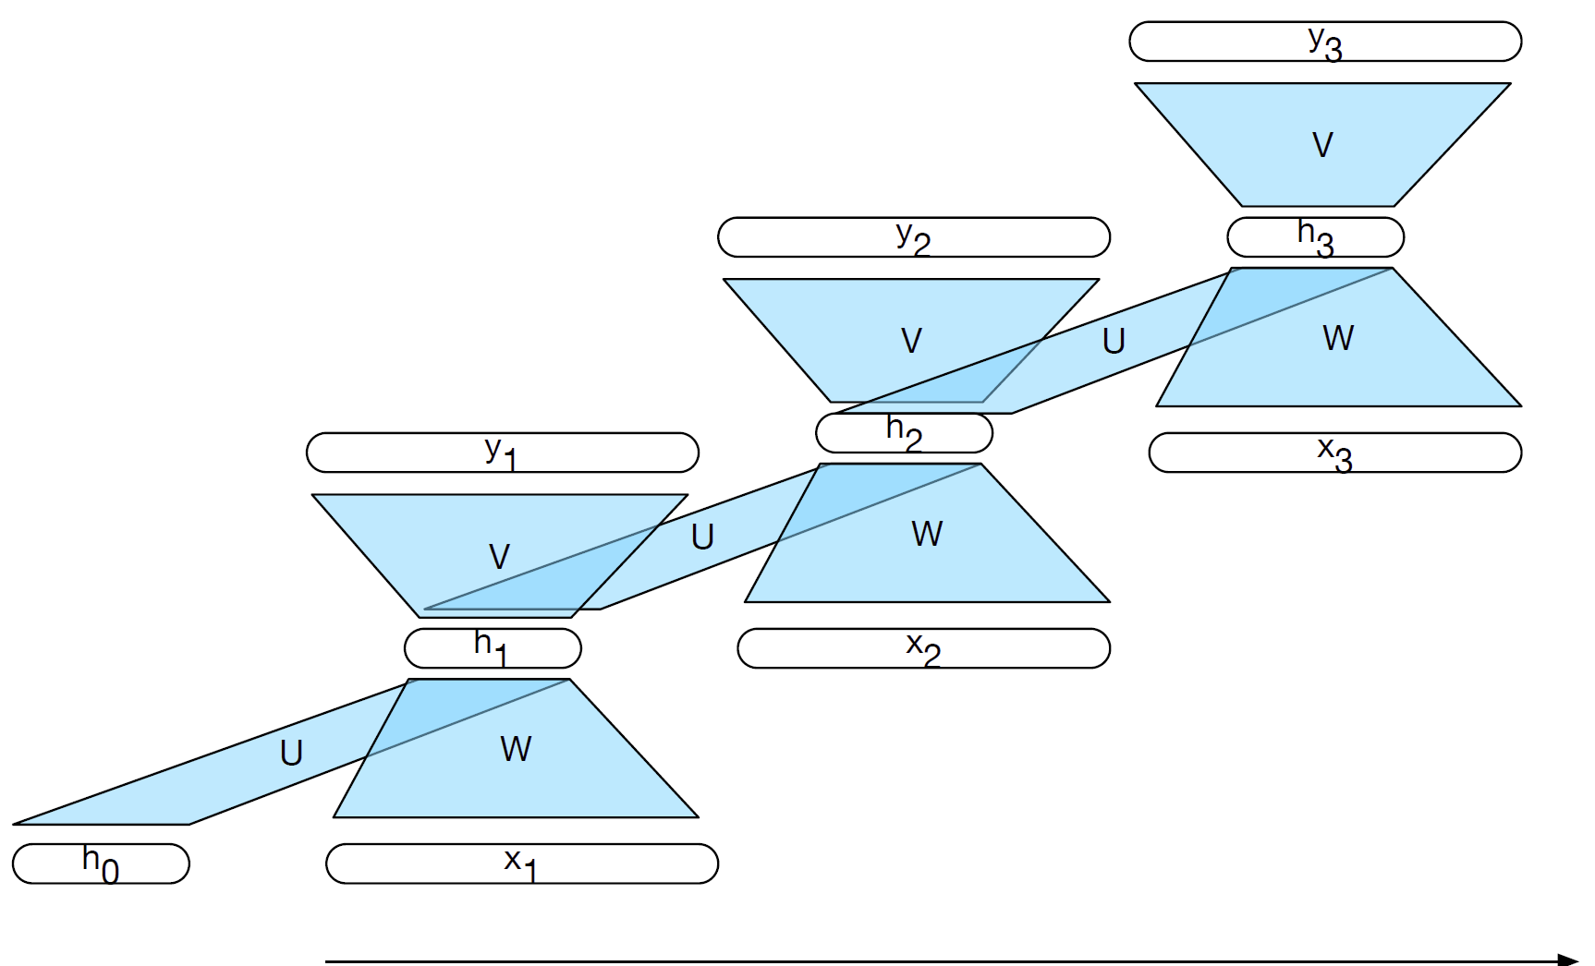
Unroll over time

Slide 9
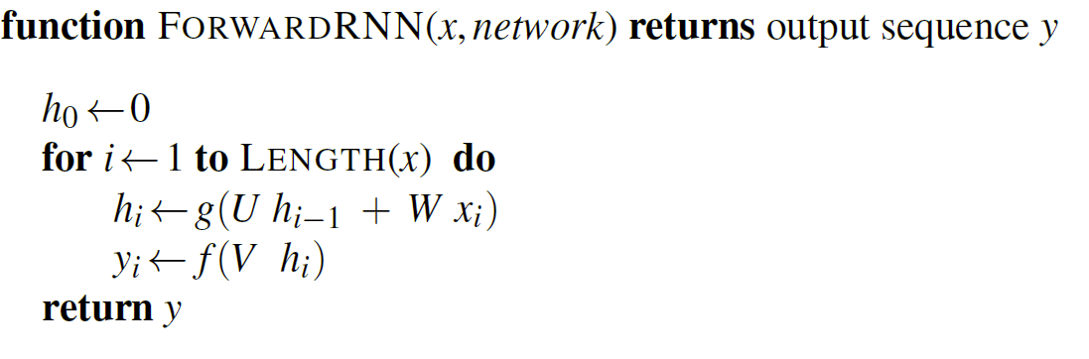

Slide 10
Training RNN
You can check this video :
https://www.youtube.com/watch?v=RrB605Mbpic

Slide 11
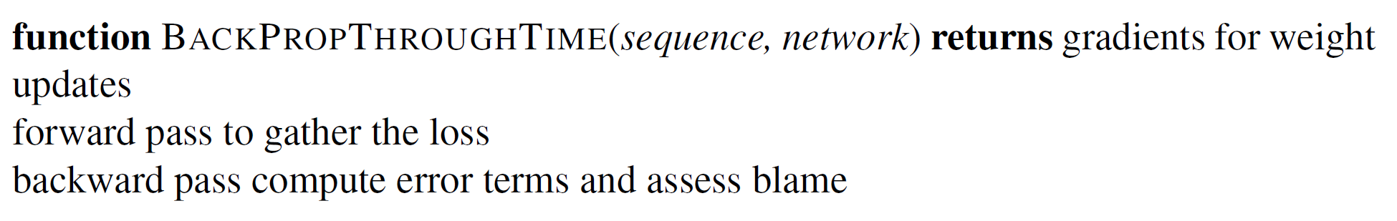
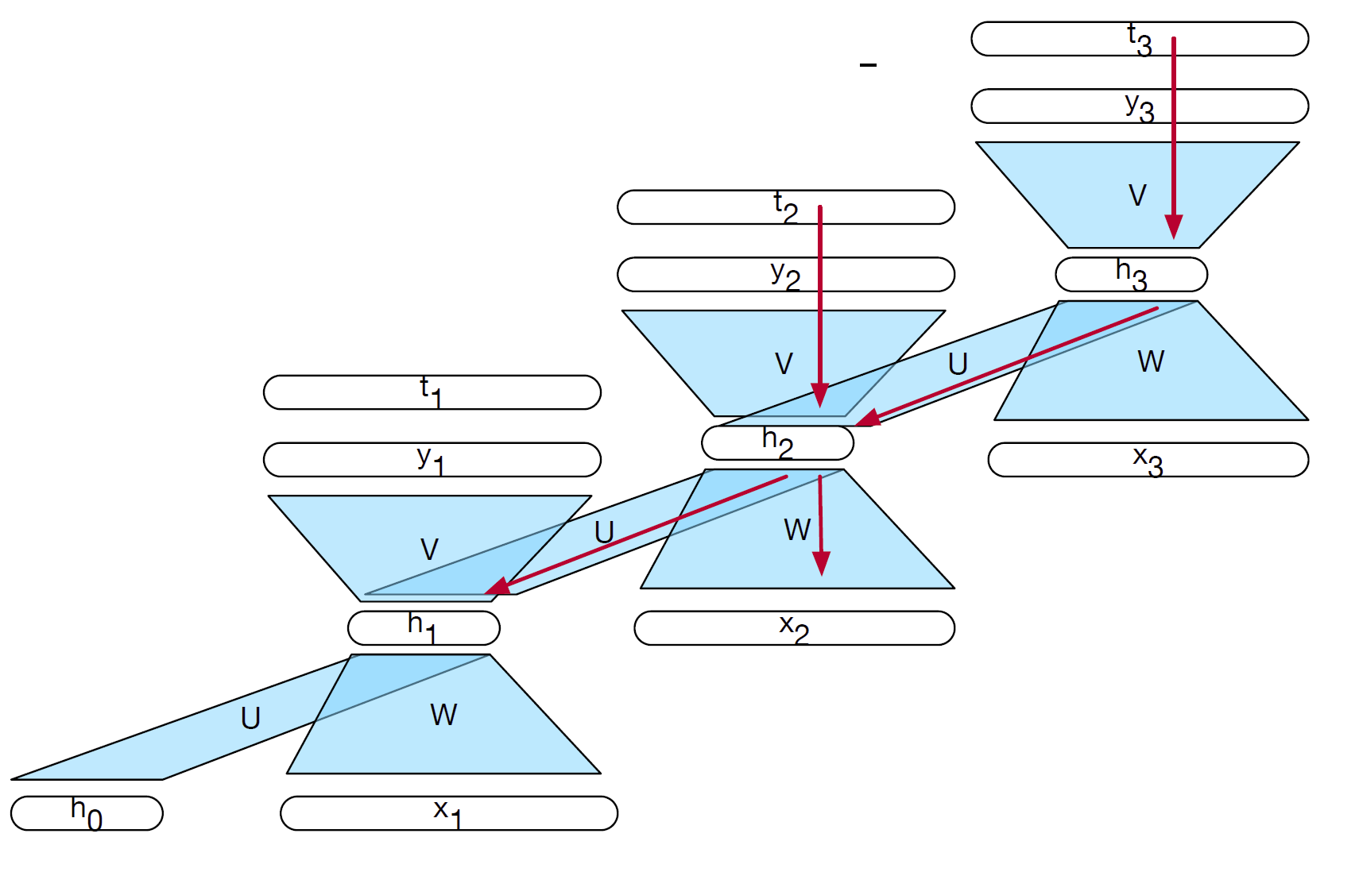
training

Slide 12
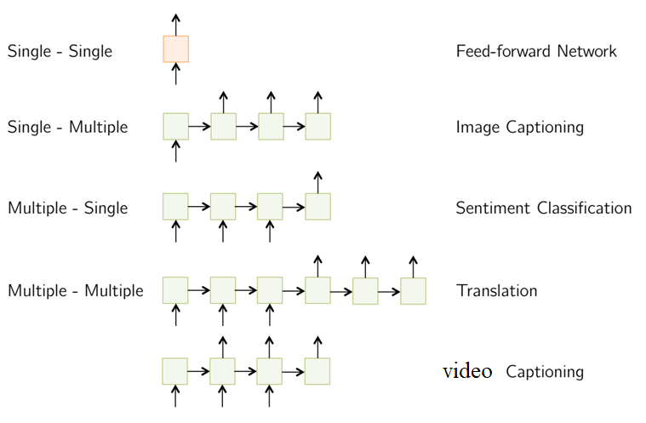
RNN Applications

Slide 13
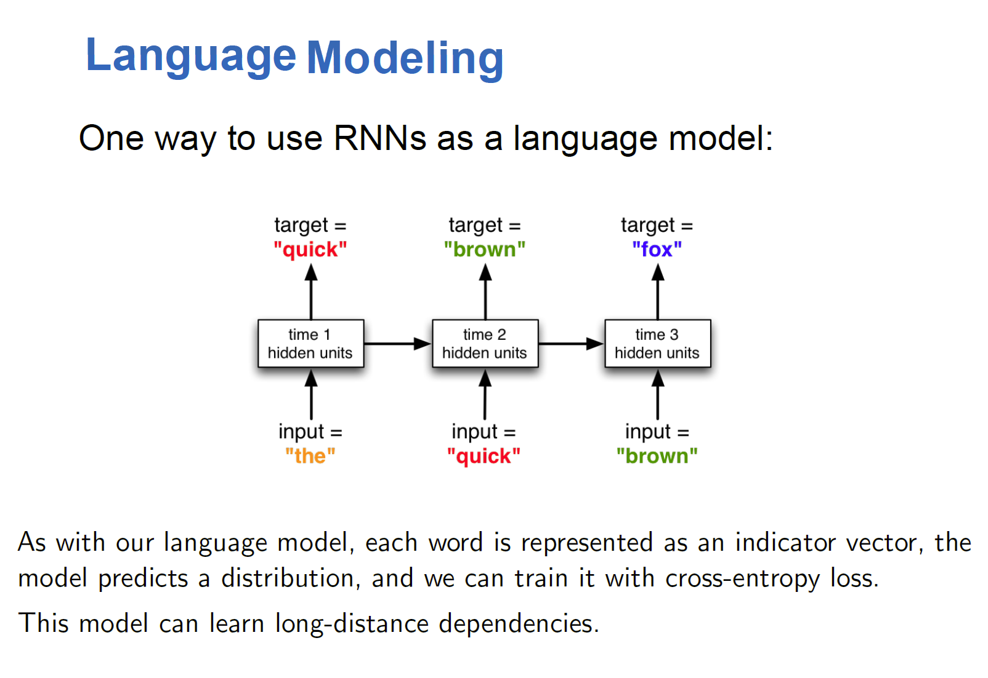
RNN Applications

Slide 14
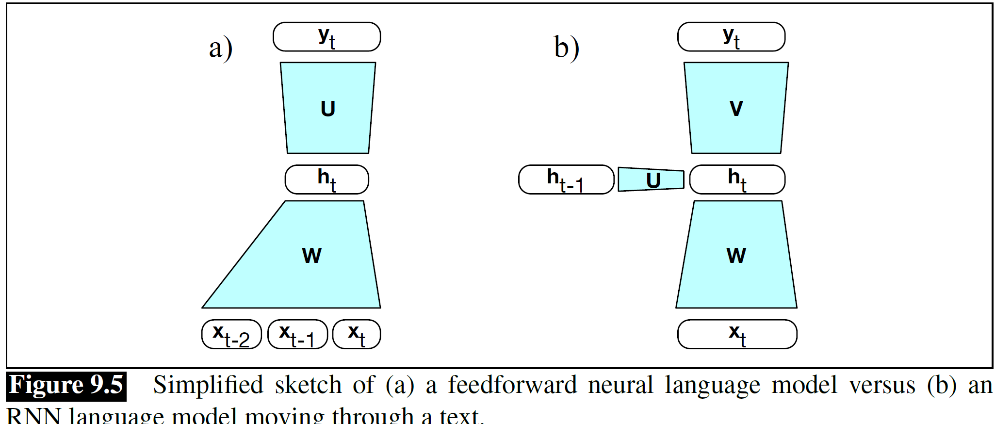
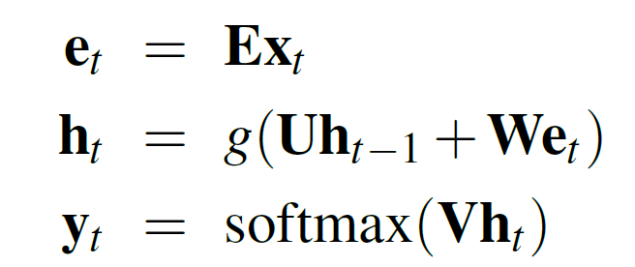
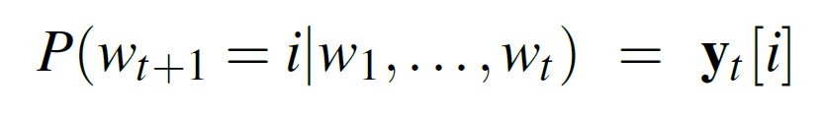
RNN LM
Xt: one hot vector
E : embedding vector

Slide 15
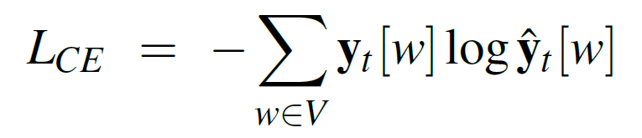
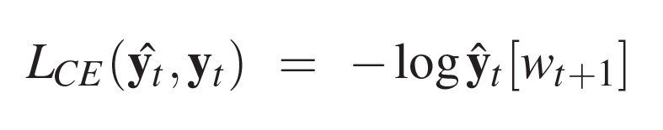
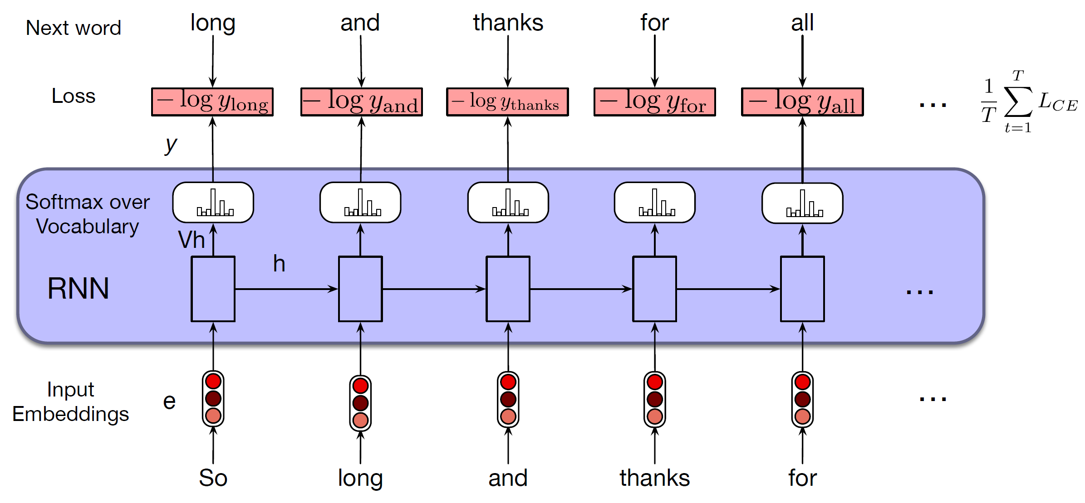
Training an RNN language model, self-supervision

Slide 16
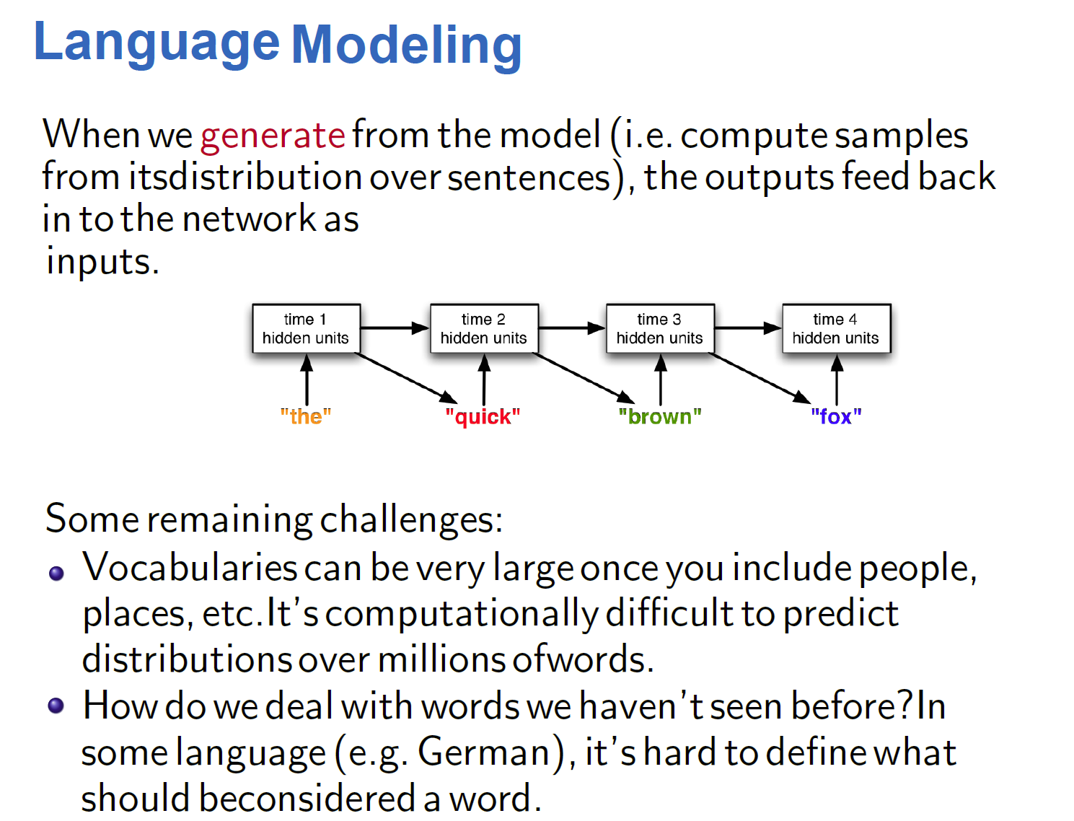
RNN Applications

Slide 17
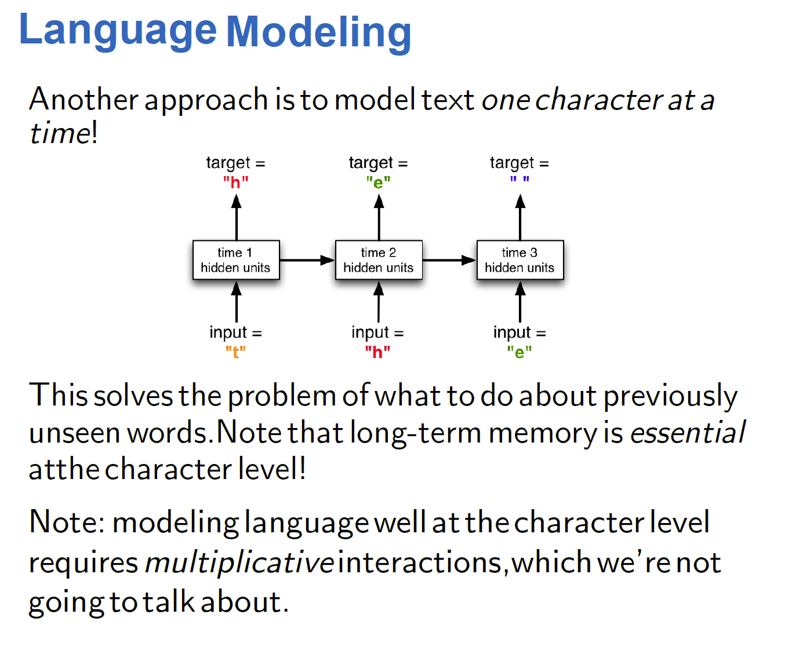
RNN Applications

Slide 18
Application: Sequence Labeling
In a recurrent network-based approach to POS tagging, inputs are words and the outputs are tag probabilities generated by a softmax layer over the POS tagset
the inputs at each time step are pre-trained word embeddings
RNN block is an abstraction that represents an unrolled simple recurrent network consisting of an input layer, hidden layer, and output layer at each time step
The outputs of the network at each time step represent the distribution over the POS tagset generated by a softmax layer
The loss function is cross entropy

Slide 19
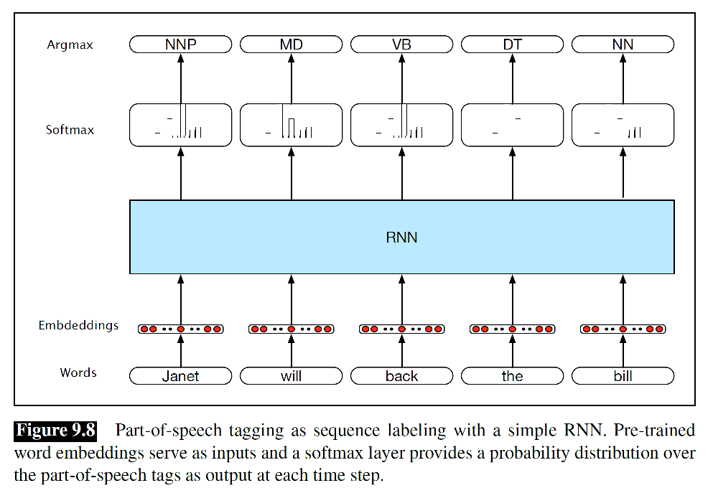

Slide 20
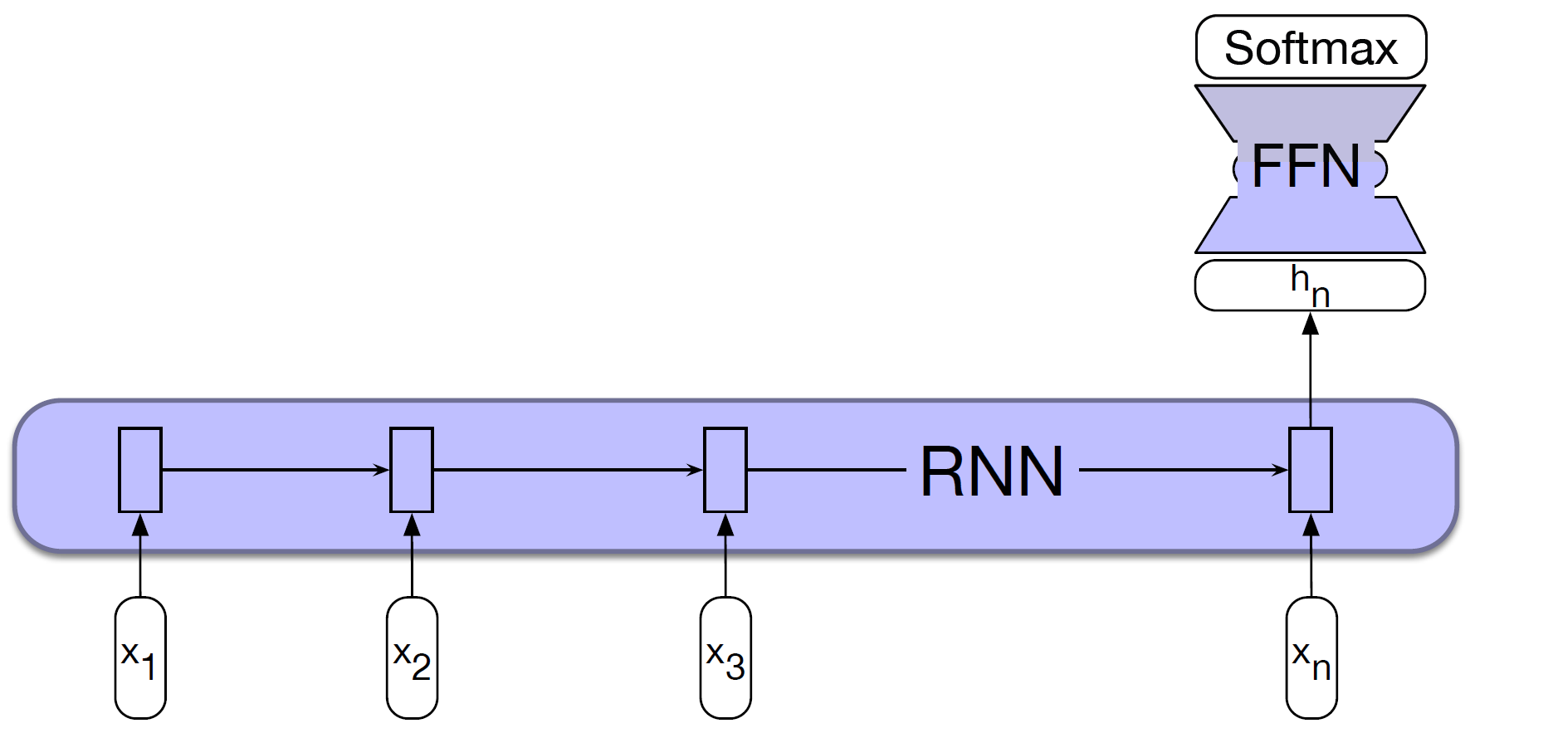
RNN for Sequence Classification
Sentiment analysis or spam detection

Slide 21
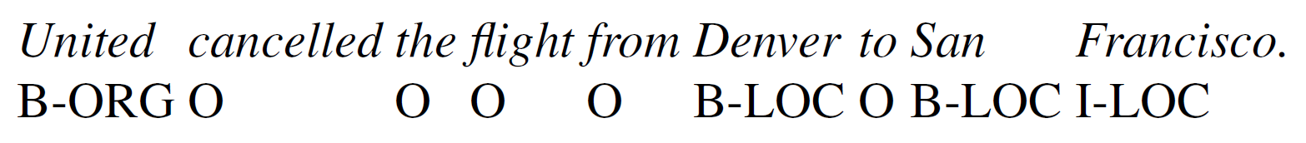
named entity recognition
finding all the spans in a text that correspond to names of people, places or organizations
IOB encoding:
B: begging, I: inside, O: outside

Slide 22
RNN Applications Natural Language Generation
autoregressive generation
To begin, sample the first word in the output from the softmax distribution that results from using the beginning of sentence marker, <s>, as the first input.
Use the word embedding for that first word as the input to the network at the next time step, and then sample the next word in the same fashion.
Continue generating until the end of sentence marker, </s>, is sampled or a fixed length limit is reached.
this architecture has inspired state-of the-art approaches to applications such as machine translation, summarization, and question answering.

Slide 23
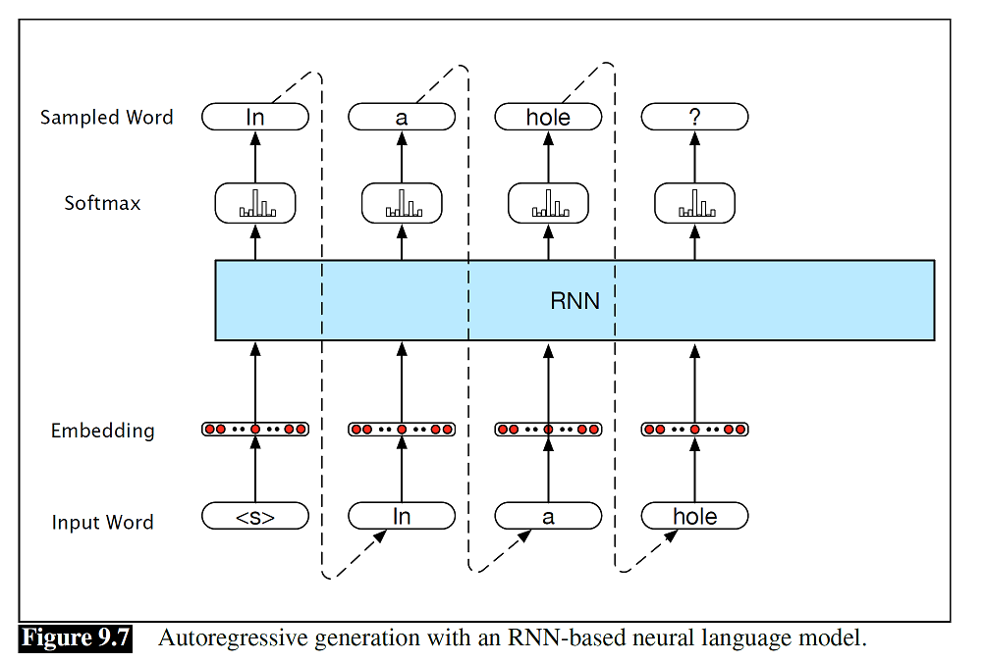

Slide 24
Deep Networks:
Stacked
Bidirectional RNNs

Slide 25
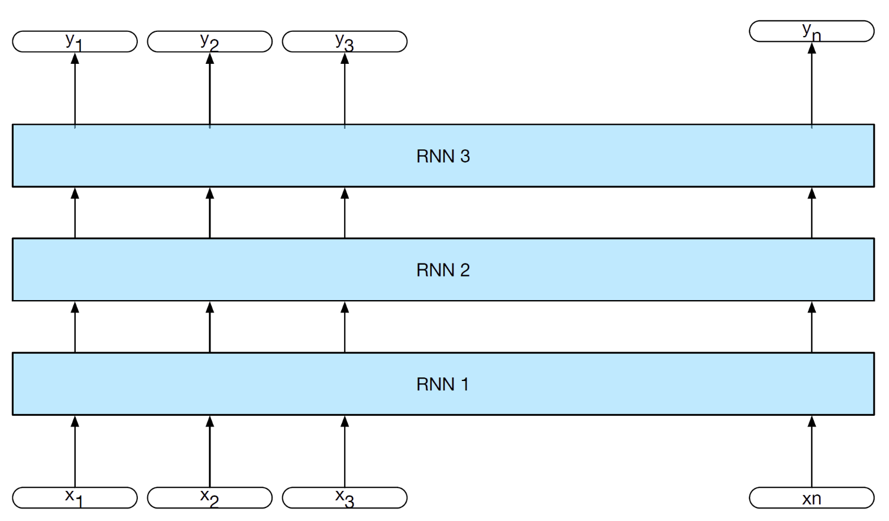
Stacked RNNs
Ability to induce representations at differing levels of abstraction across layers
Just as the early stages of the human visual system detect edges that are then used for finding larger regions and shapes, the initial layers of stacked networks can induce representations that serve as useful abstractions for further layers

Slide 26
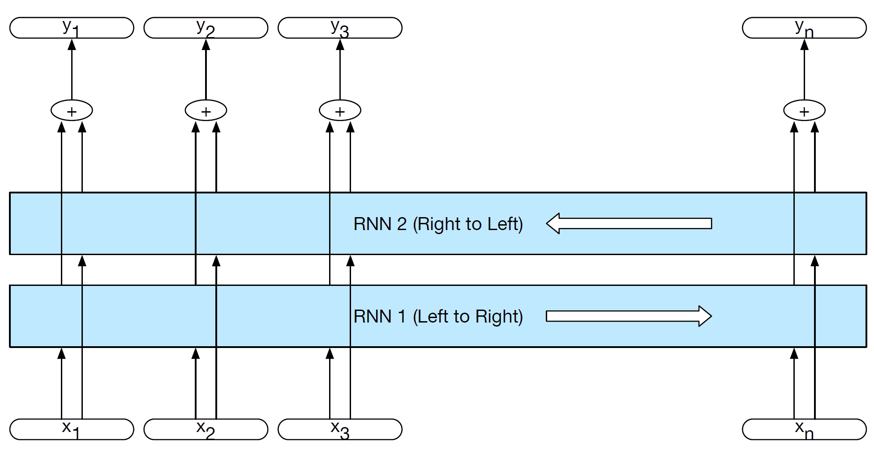
Bidirectional RNNs for sequence labelling

Slide 27
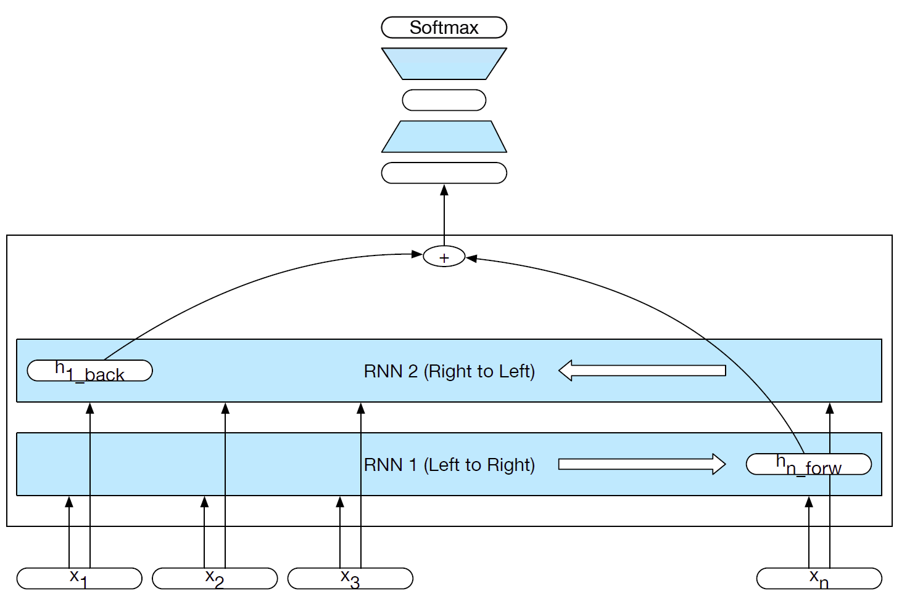
bidirectional RNN for sequence classification

Slide 28
Managing Context in RNNs: LSTMs and GRUs
LM for sentence:
“The flights the airline was cancelling were full”.
assigning an appropriate probability to were is quite difficult, not only because the plural flights is quite distant
a network should be able to retain the distant information about plural flights until it is needed
RNN are being asked to perform two tasks simultaneously:
Provide information useful to the decision being made in the current context, and
Updating and carrying forward information useful for future decisions

Slide 29
vanishing gradients or exploding gradients,
second difficulty:
during the backward pass of training, the hidden layers are subject to repeated dot products, as determined by the length of the sequence. A frequent result of this process is that the gradients are either driven to zero or saturate.
more complex network architectures have been designed
as a kind of memory unit that needs to be managed explicitly
the network needs to forget information that is no longer needed and to remember information as needed for later decisions

Slide 30
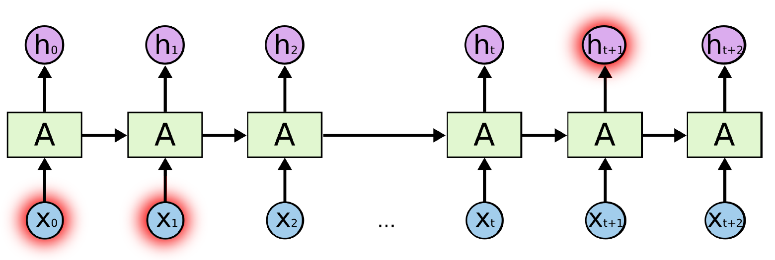
Long Short-Term Memory(LSTM)
“the clouds are in the sky”
No gap between relevant words (clouds and sky)
“I grew up in France, …, I speak fluent French.”
Gap between relevant information is the point … it needs more context
RNNs don’t seem to be able to learn them-LSTM does

Slide 31
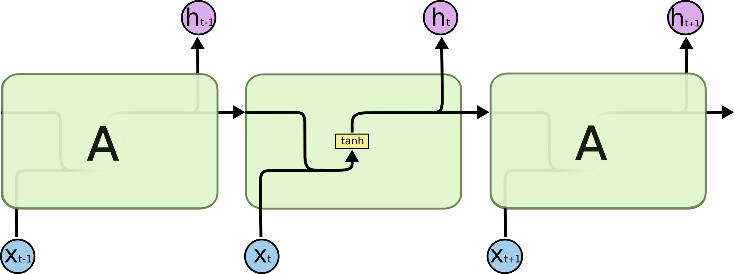
RNN repeating module
Just one layer(hidden)

Slide 32
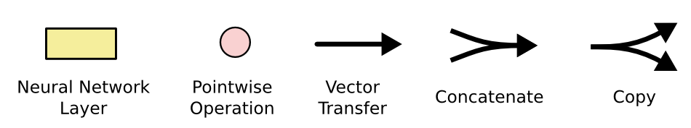

Long Short-Term Memory(LSTM)
Four layers:

Slide 33
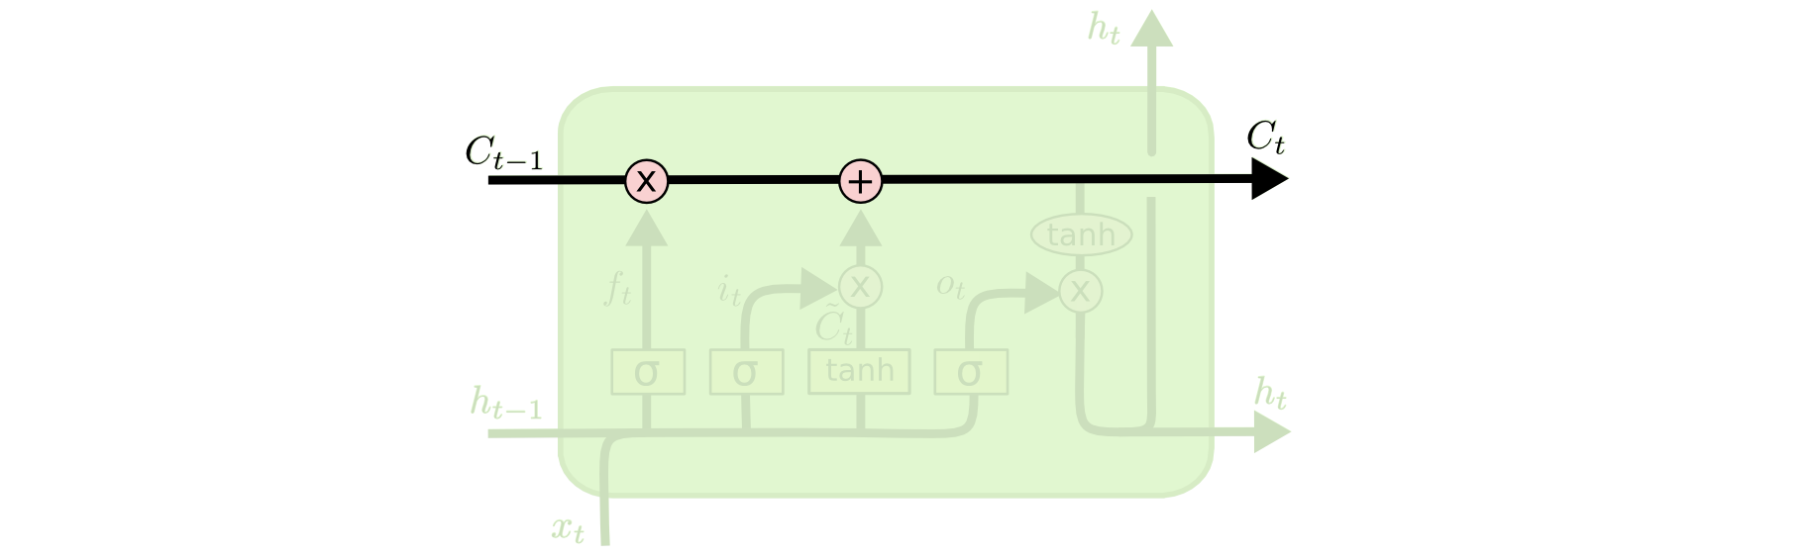
Core Idea
The key to LSTMs is the cell state, the horizontal line running through the top of the diagram
LSTM does have the ability to remove or add information to the cell state, carefully regulated by structures called gates
remove
add
Cell state
hidden state

Slide 34
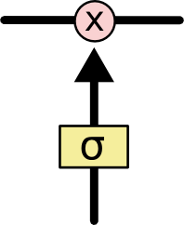
gate
Gates are a way to optionally let information through
composed out of a sigmoid neural net layer and a pointwise multiplication operation
Sigmoid layer outputs numbers between zero and one
zero means “let nothing through,”
one means “let everything through!
Three gates:
Forget gate
Input gate
Output gate

Slide 35
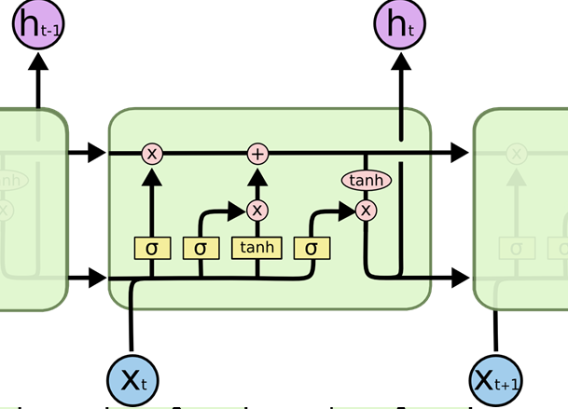
Long Short-Term Memory(LSTM)
input gate
output gate
Forget gate

Slide 36
Forget gate layer
First step in our LSTM is to decide what information we’re going to throw away from the cell state
a sigmoid layer called the “forget gate layer.”
It looks at ht−1 and xt, and outputs a number between 0 and 1 for each number in the cell state Ct−1.
A 1 represents “completely keep this”
while a 0 represents “completely get rid of this.”
In LM, cell state include the gender of the present subject
the correct pronouns can be used.
When we see a new subject, we want to forget the gender of the old subject.

Slide 37
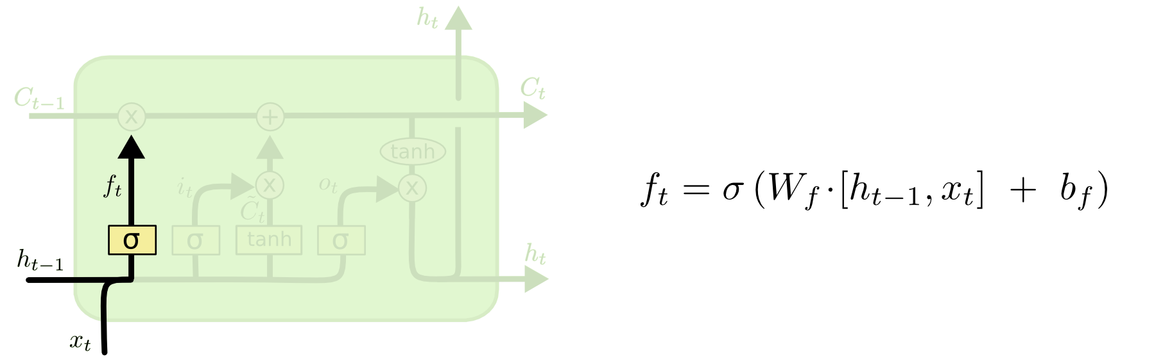
Forget gate

Slide 38
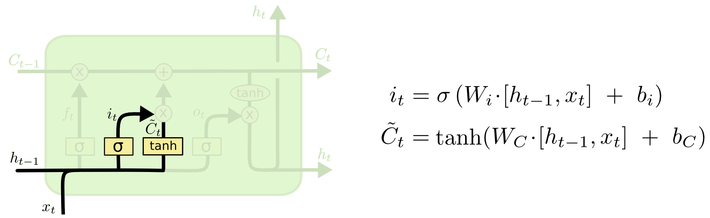
input gate layer
decide what new information we’re going to store in the cell state
a sigmoid layer called the “input gate layer” decides which values we’ll update
Next, a tanh layer creates a vector of new candidate values, C_{t}, that could be added to the state.

Slide 39
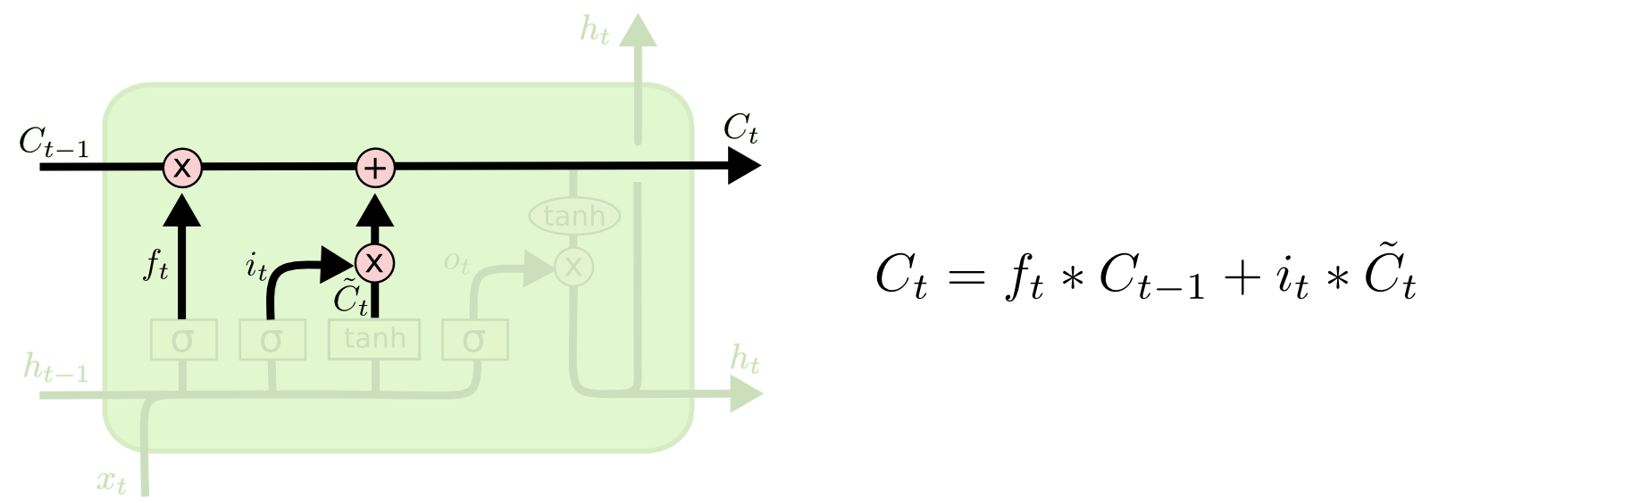
input gate layer
update the old cell state, Ct−1, into the new cell state Ct
multiply the old state by ft, forgetting the things we decided to forget earlier. Then we add it∗C~t

Slide 40
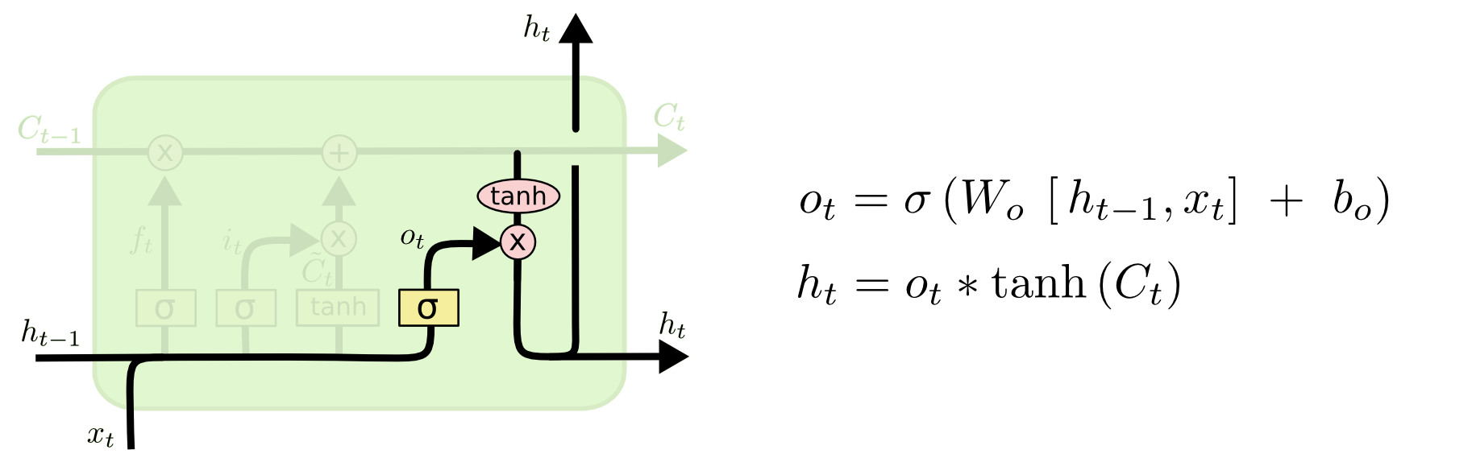
Output gate
decide what we’re going to output
run a sigmoid layer which decides what parts of the cell state we’re going to output
put the cell state through tanh (to push the values to be between −1 and 1) and multiply it by the output of the sigmoid gate

Slide 41
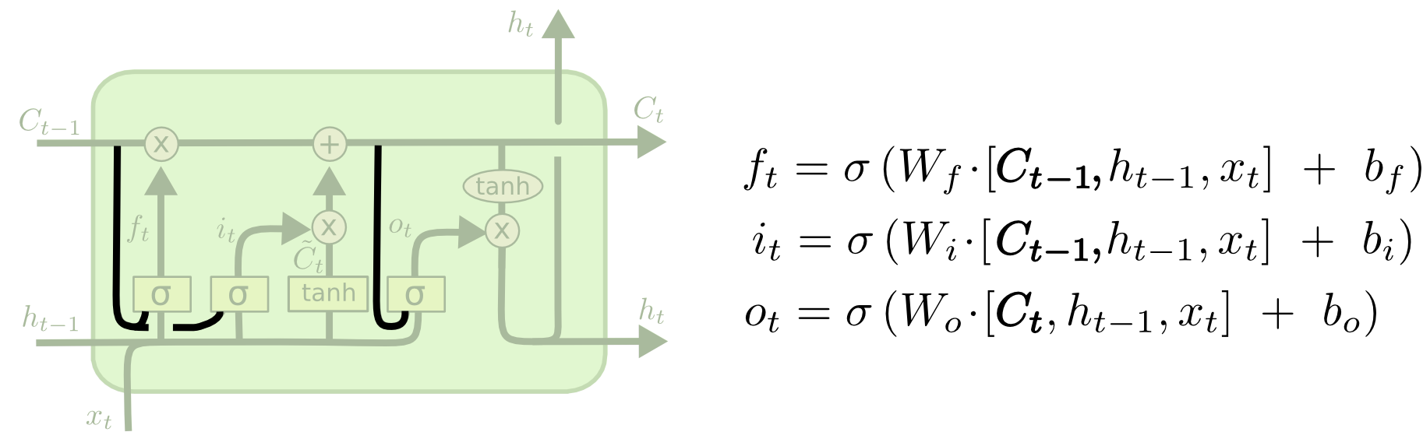
Variants on Long Short Term Memory
peephole connections:we let the gate layers look at the cell state.

Slide 42
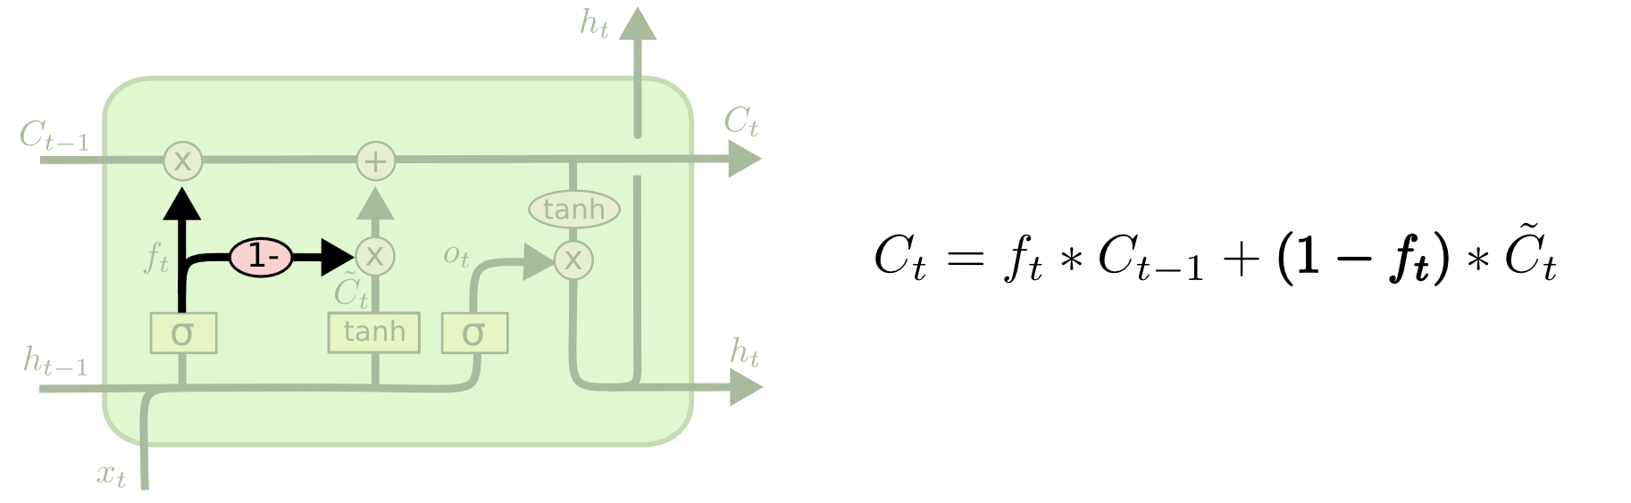
coupled forget and input gates.
Another variation is to use coupled forget and input gates.
We only forget when we’re going to input something in its place.

Slide 43
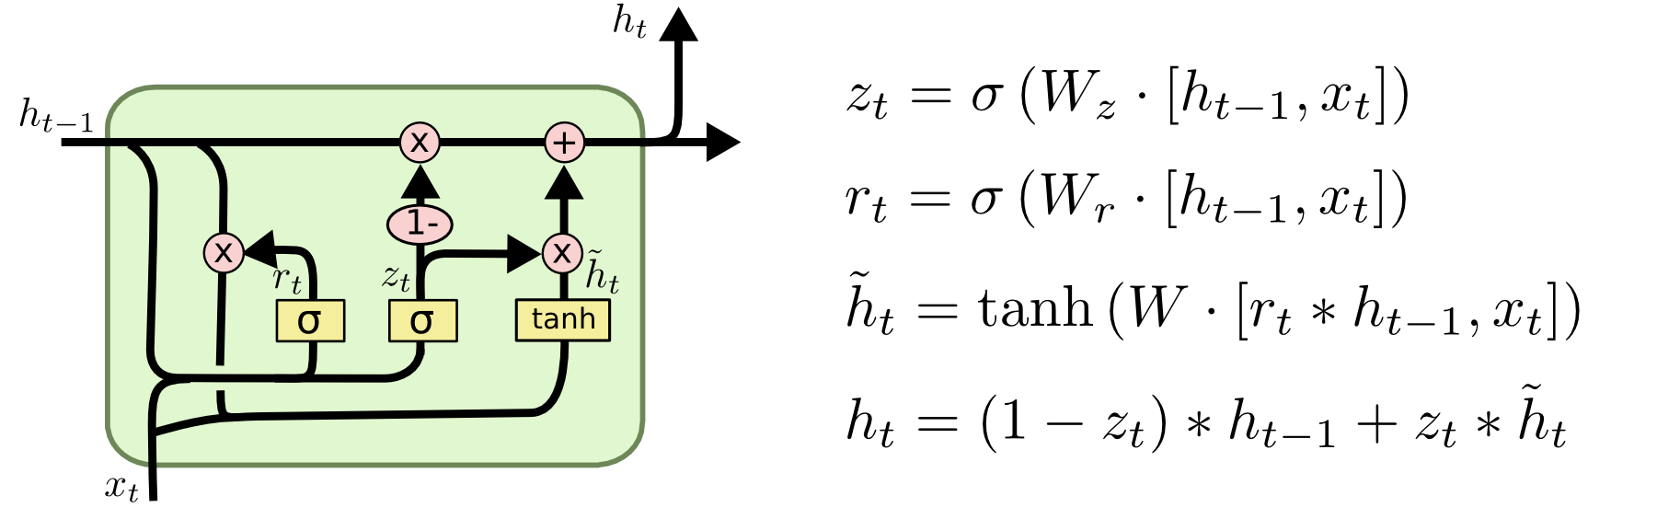
Gated Recurrent Unit(GRU)
combines the forget and input gates into a single “update gate.
merges the cell state and hidden state, and makes some other changes
Reset and update gate

Slide 44
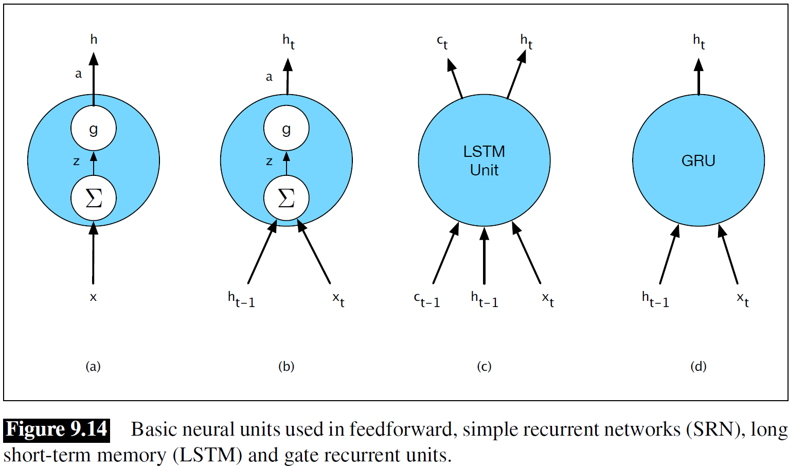

Slide 45
Words, Characters and Byte-Pairs
For some languages and applications, the lexicon is simply too large to practically represent every possible word as an embedding
we will always encounter unknown words due to new words entering the language
Morphological information, below the word level, is clearly an important source of information for many applications
Ignore words altogether and simply use character sequences as the input to RNNs
Use subword units such as those derived from byte-pair encoding or phonetic analysis as inputs
Use full-blown morphological analysis to derive a linguistically motivated input sequence

Slide 46
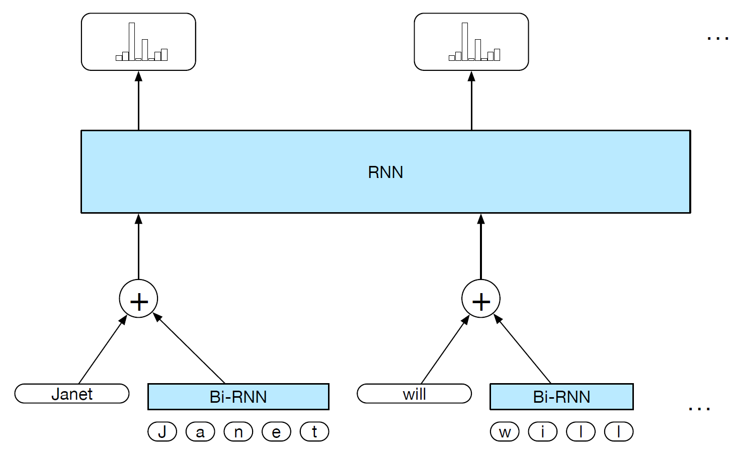
character-level word embeddings

Slide 47
